Slide 1
Java 13*
Jonathan Ohara de Araujo

Slide 2
Agenda
JEP 350
JEP 351
JEP 353
JEP 354
JEP 355

Slide 3
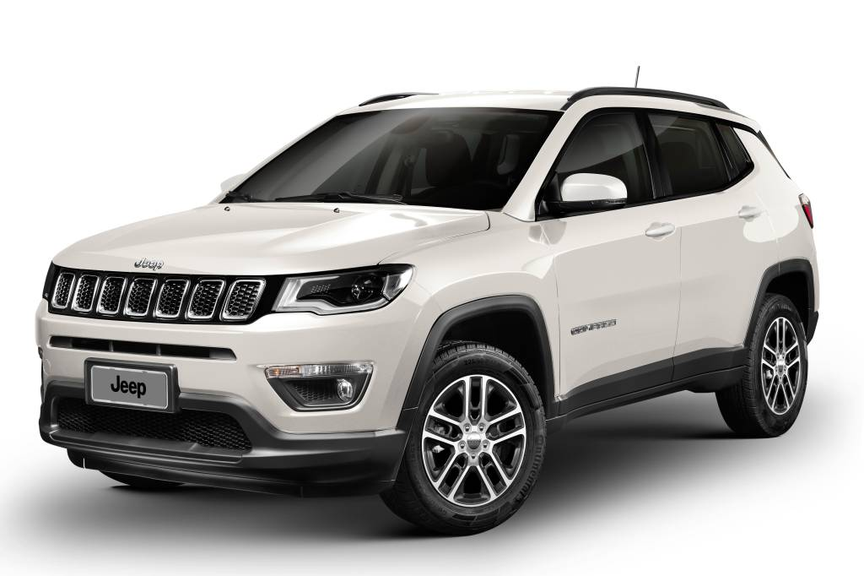

Slide 4
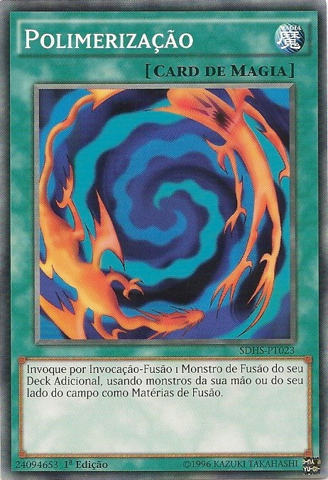



Slide 5
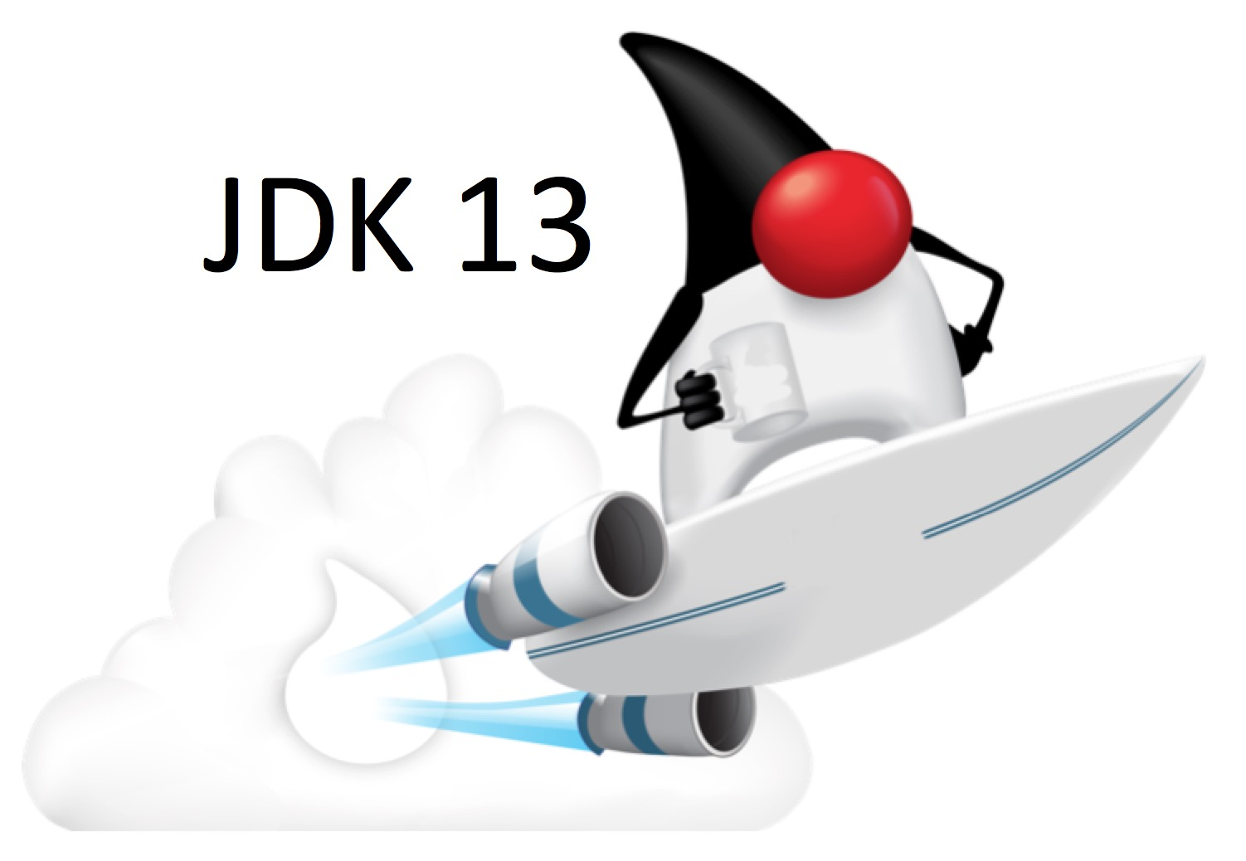

Slide 6
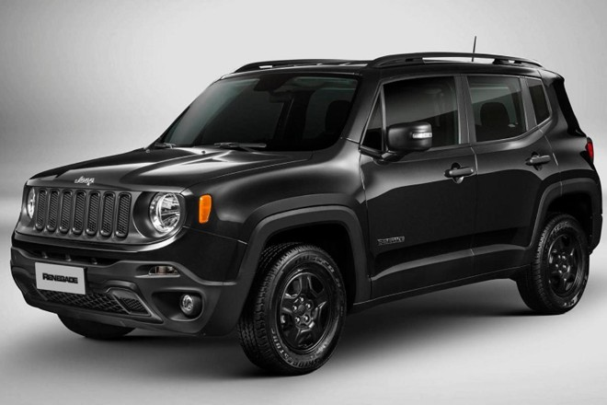
3 5 0

Slide 7
JEP 350: Dynamic CDS Archives
Started on Java 12
More:
The lean, mean… OpenJDK?
https://vimeo.com/360835777

Slide 8
JEP 350: Dynamic CDS Archives
Archiving:
java –XX:ArchiveClassesOnExit=MyApp.jsa MyApp
Unarchiving:
Java –XX:SharedArchiveFile=MyApp.jsa MyApp

Slide 9

3 5 1

Slide 10
JEP 351: Uncommit Unused Memory
Improvement to ZGC
“ZGC does not currently uncommit and return memory to the operating system, even when that memory has been unused for a long time. This behavior is not optimal for all types of applications and environments, especially those where memory footprint is a concern.”
https://wiki.openjdk.java.net/display/zgc/Main

Slide 11
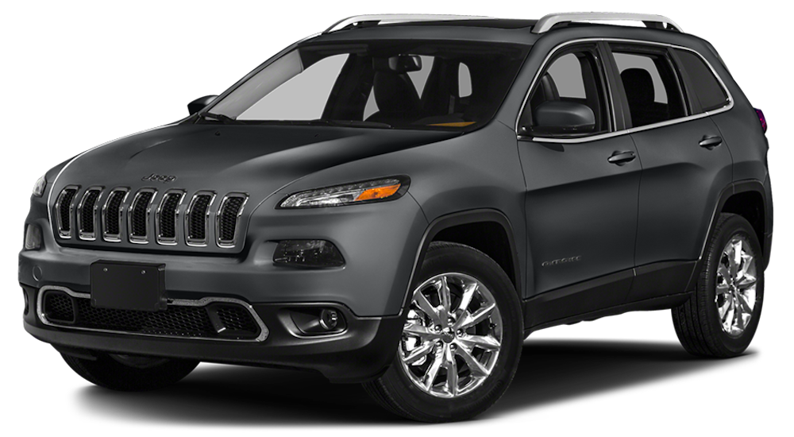
3 5 3

Slide 12
JEP 353: Reimplement the Legacy Socket API
Improvement to ZGC
“ZGC does not currently uncommit and return memory to the operating system, even when that memory has been unused for a long time. This behavior is not optimal for all types of applications and environments, especially those where memory footprint is a concern.”
https://wiki.openjdk.java.net/display/zgc/Main

Slide 13
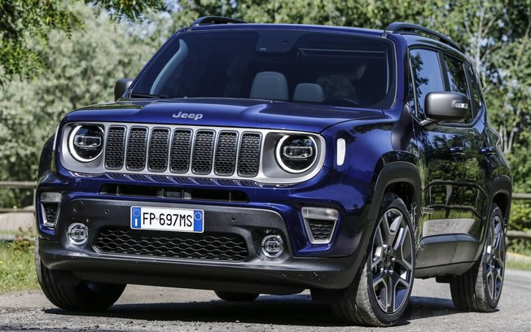
3 5 4

Slide 14
JEP 354: Switch expressions
Started on Java 12

Slide 15
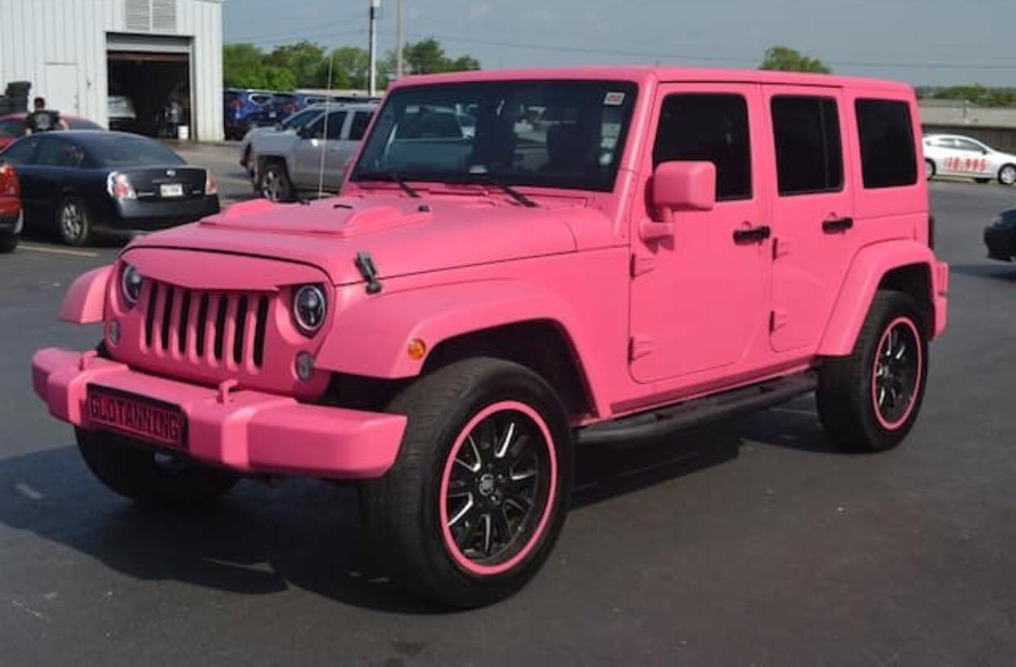
3 5 5

Slide 16
JEP 355: Text Expressions

Slide 17
E X T R A

Slide 18

Questions?

Slide 19
Thank you!

